Slide 1

The Vinyl Shop
Notes:
INTRODUCTION: theme (Vinyl Shop) + introduce the group + establish that the questions should be asked in the end of the presentation

Slide 2

Introduction
Internet has been connecting people and businesses since 1990s;
New forms of goods, services and delivery channels (e-business);
There are some traditional shops;
Conducting a feasibility study has the advantage of giving advance warning about where the project has more chances of failure.
2

Slide 3

Current Functional Procedures
Small business specialized in selling second-hand entertainment items;
All the transactions and documentation: archived manually;
There are a few constraints.
2

Slide 4

Project Objectives
Three distinctly computerized systems to support all the routine transactions
+
Online presence of the company is which also allows customers and suppliers to perform transactions.
3

Slide 5

Feasibility Study
Technical Feasibility
Operational Feasibility
Economic Feasibility
Scheduling Feasibility
4

Slide 6
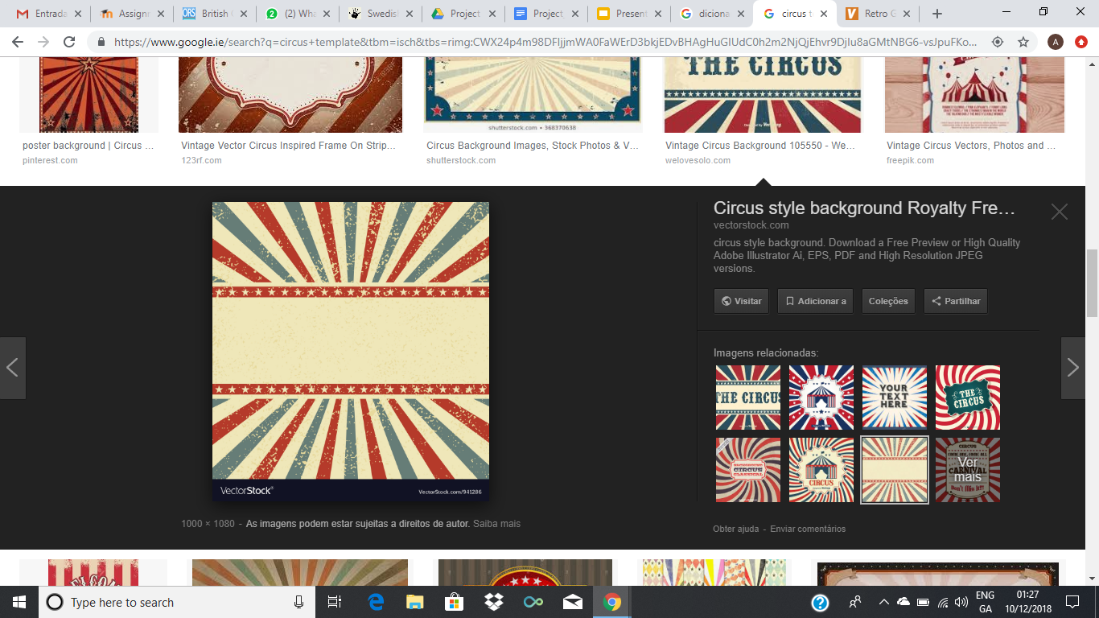
Low-Cost Alternative

Slide 7

Proposal Description
Off-the-Shelf in physical store;
EPoS
Display;
Cash drawer;
Receipt printer;
Card machine (SumUp);
EPoS software.
4
5

Slide 8
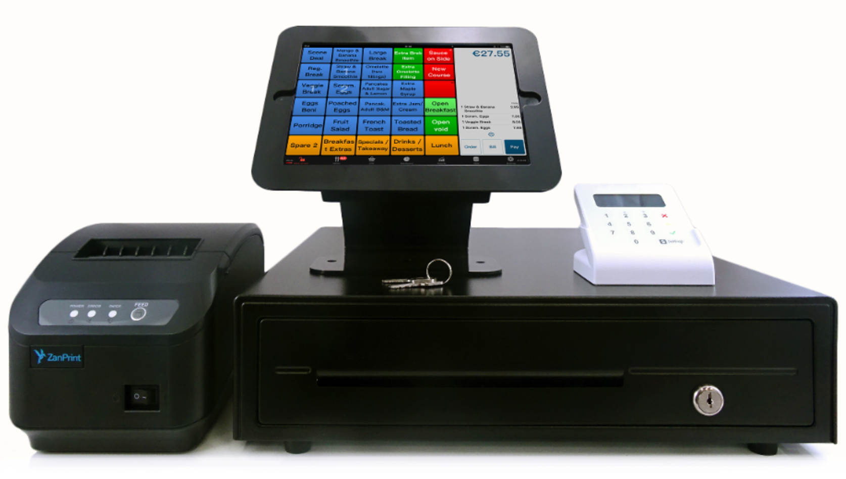
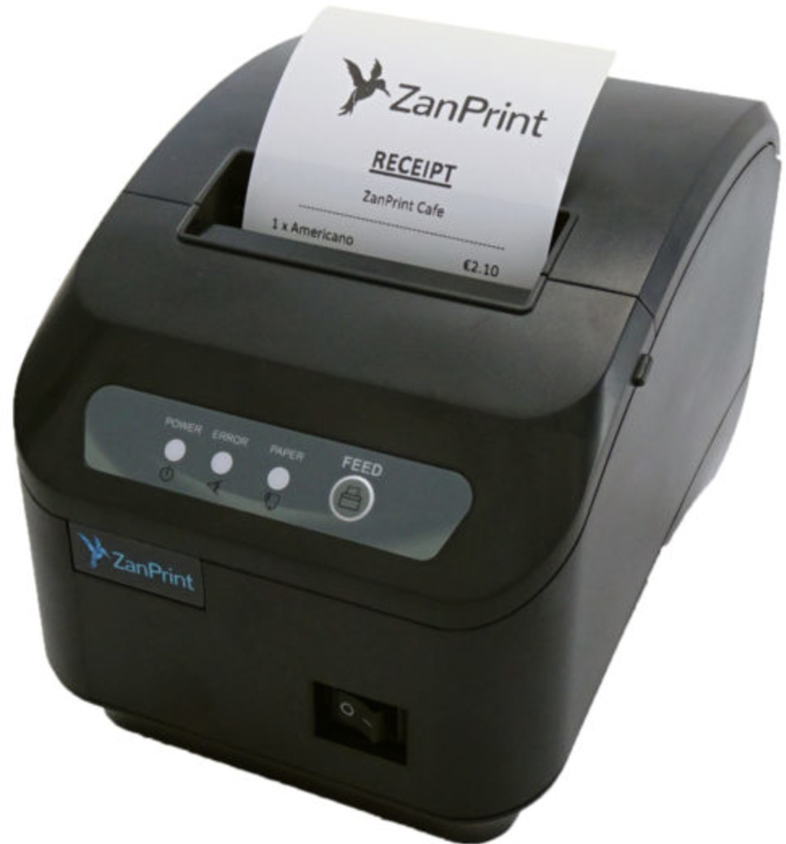
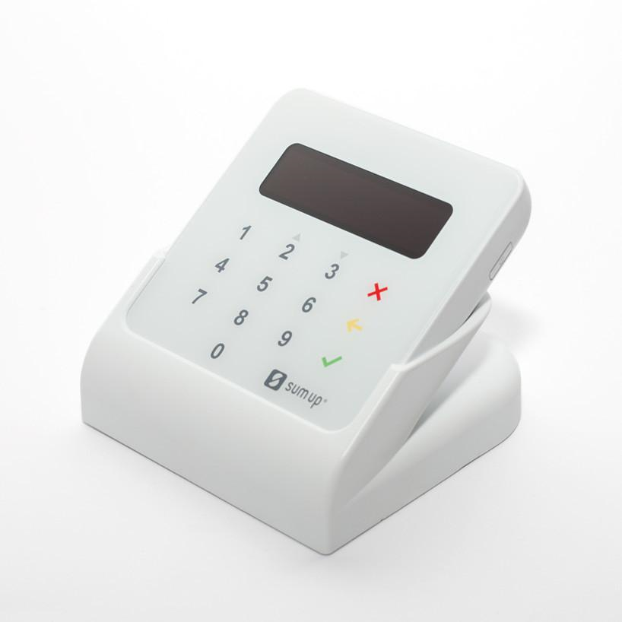
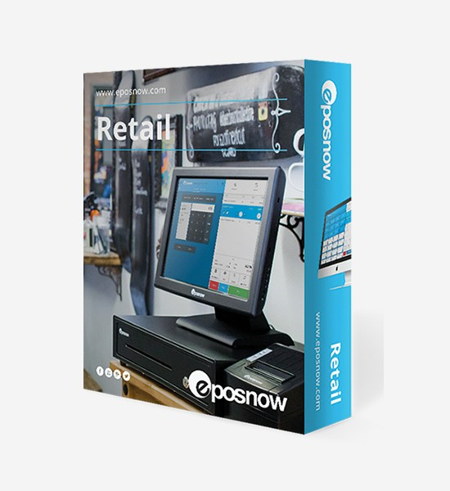
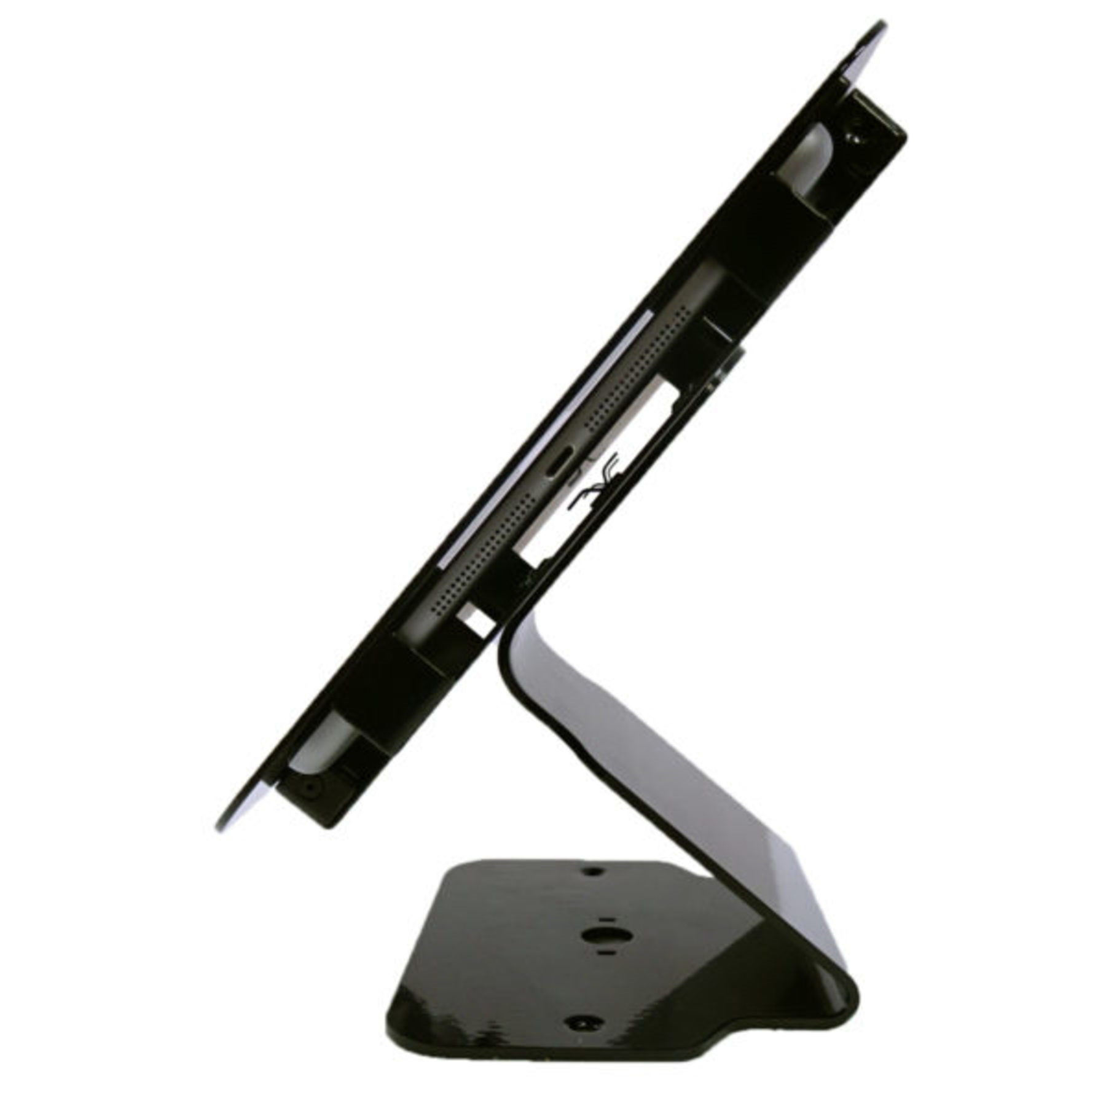
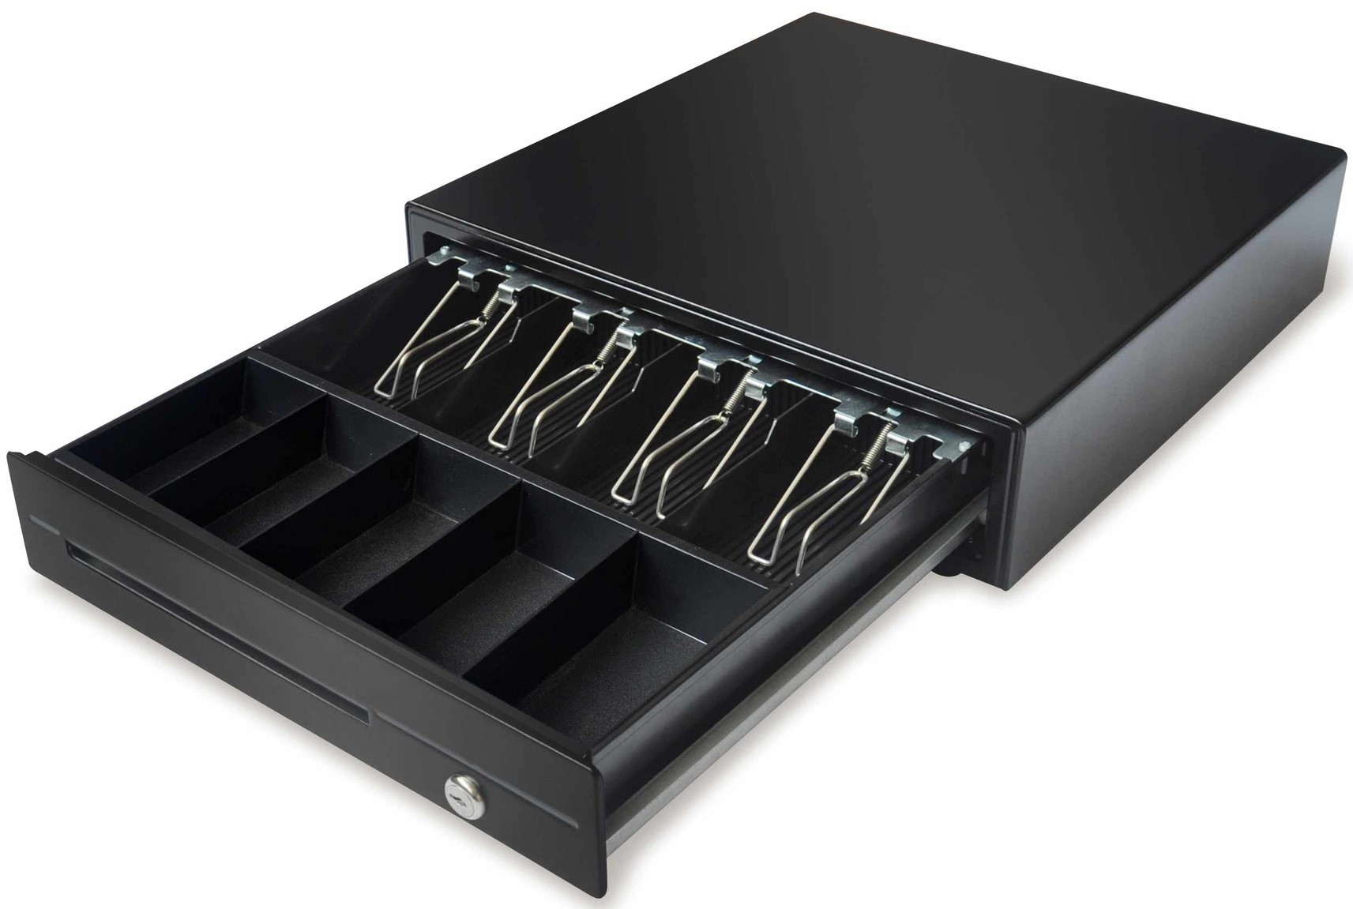
4
6

Slide 9
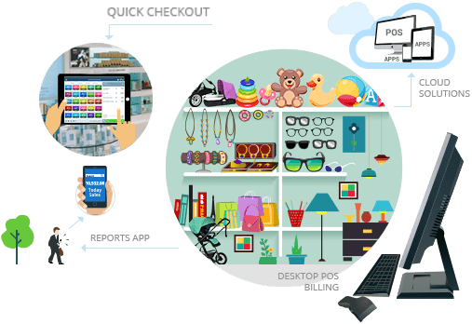
4
6

Slide 10

Feasibility study - Technical
Only a few changes in the current system;
Advantages:
Facilitates transactions;
A sort of payment methods;
Control stock supply;
Keep track of the daily sales
Training and support provided.
4
7

Slide 11

Feasibility study - Operational
Computerize the store;
Adequate throughput and response time;
Improve accuracy and reliability;
Tools against fraud;
Internet access.
4
8

Slide 12
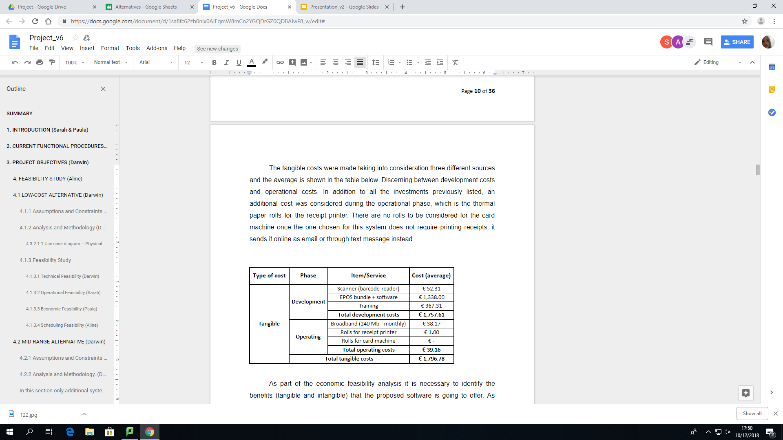
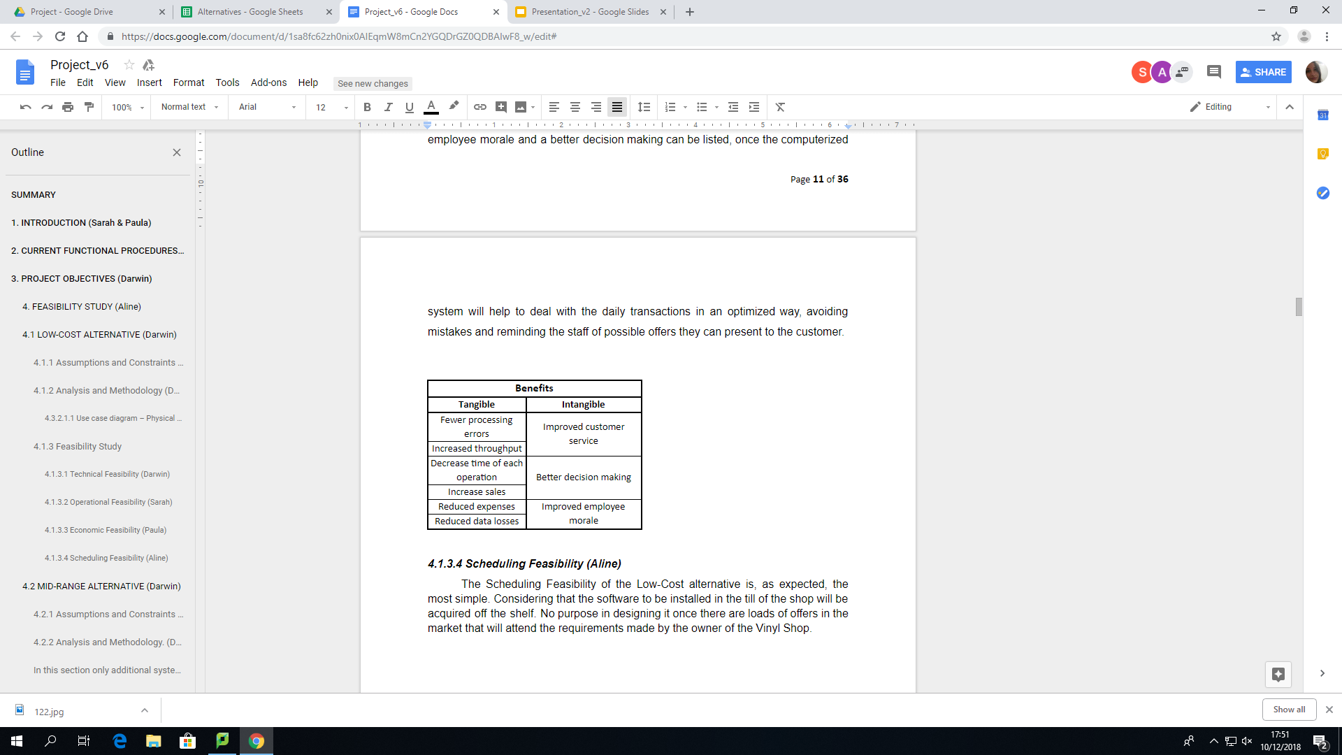
Feasibility study - Economic
4
9

Slide 13
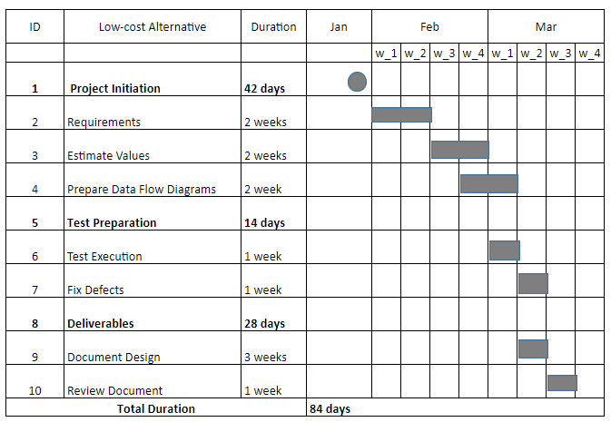
Feasibility study - Scheduling
10
4

Slide 14
Mid-Range Alternative

Slide 15

Proposal Description
Off-the-Shelf in physical store;
EPoS;
Tailored online Website;
Catalog;
Hire technical capacity for development.
11
4

Slide 16
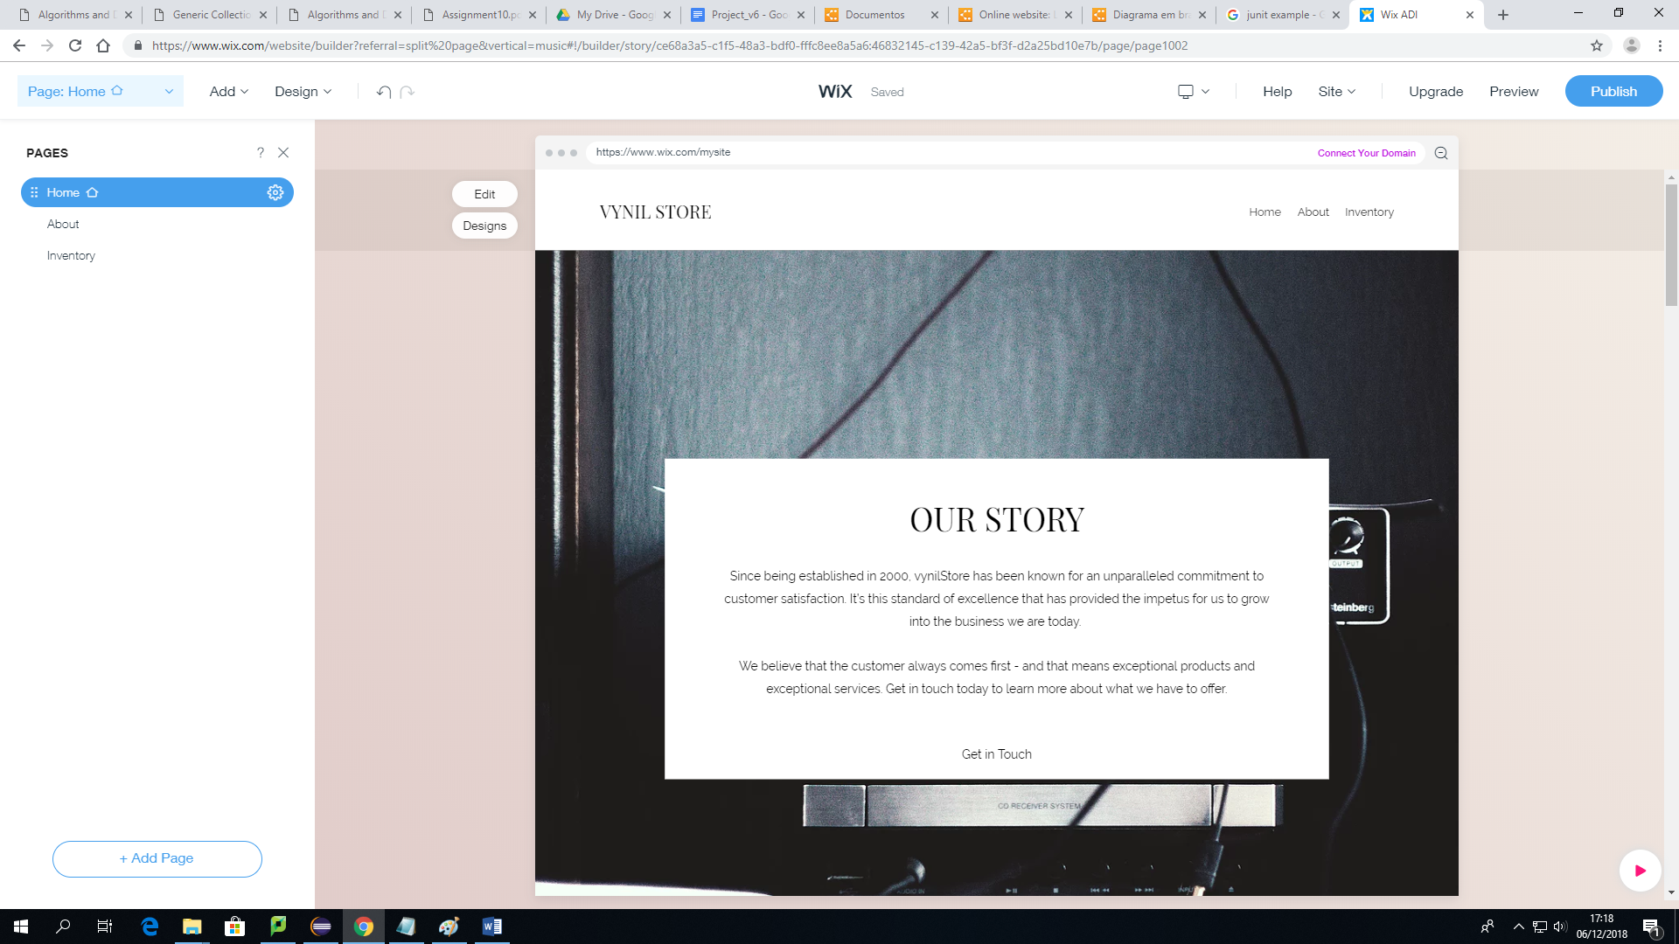
12
4

Slide 17
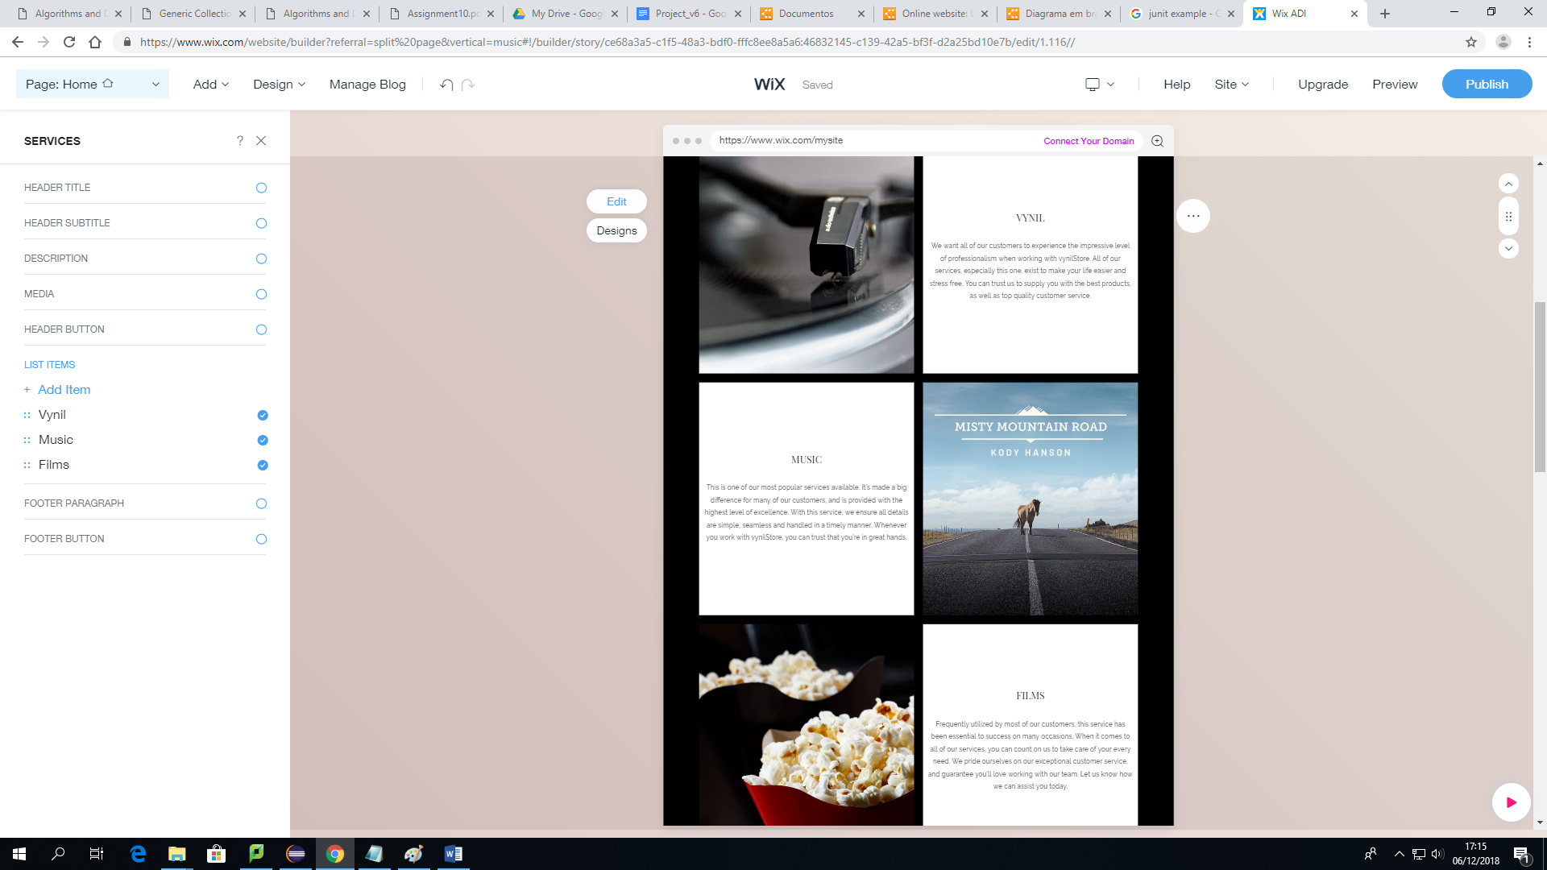
13
4

Slide 18
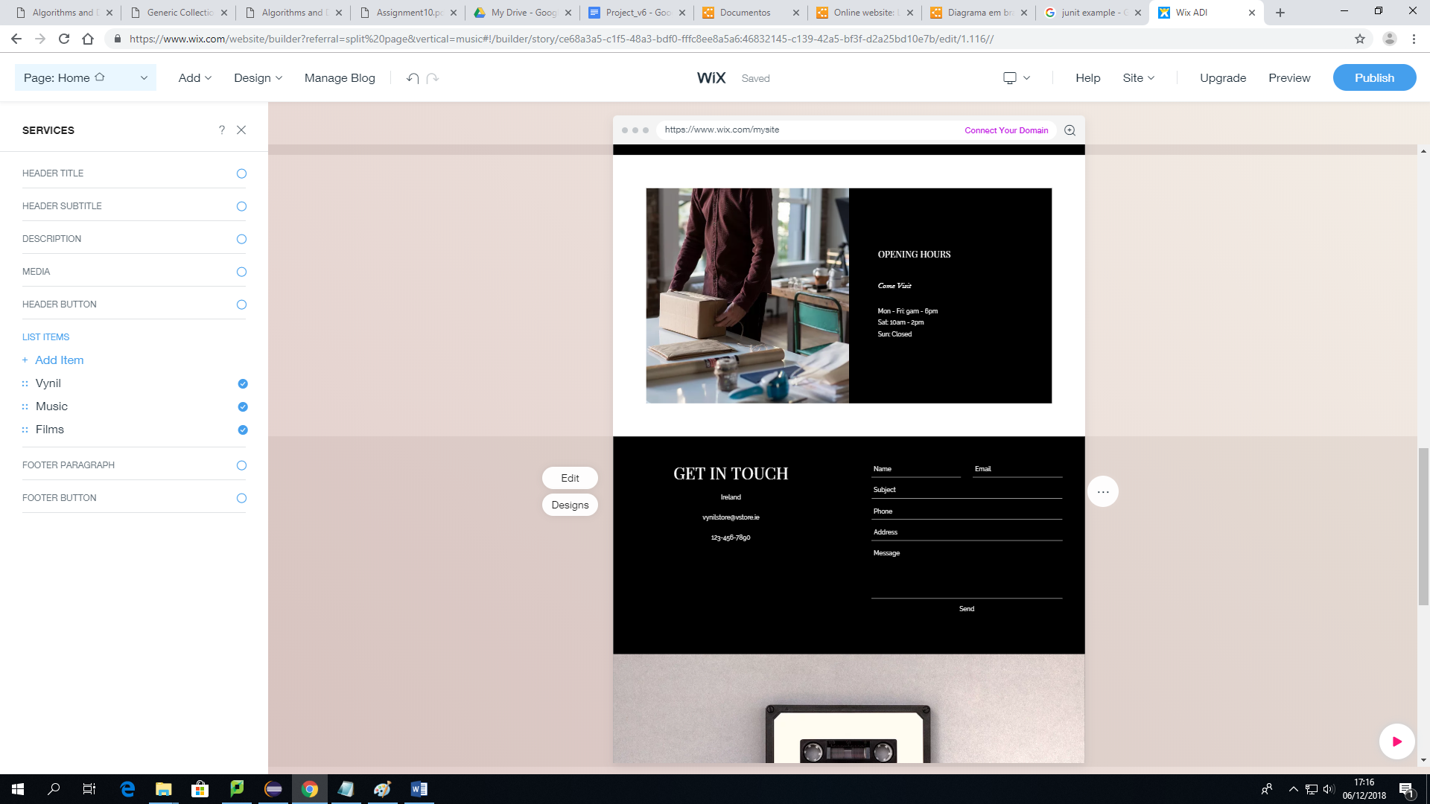
14
4

Slide 19
Feasibility study - Technical
Demands technical knowledge regarding the website;
Open Source framework;
WordPress (Content Management System);
Self Hosted
Lower setup and maintenance costs;
Less staff training;
Highly customizable for great flexibility.
15
4

Slide 20
Feasibility study - Operational
Expansion of customers to global;
Staff training;
Freelance web designer for front end;
2 to 5 hours/ month;
Support and maintenance of software is made by the seller.
16
4

Slide 21
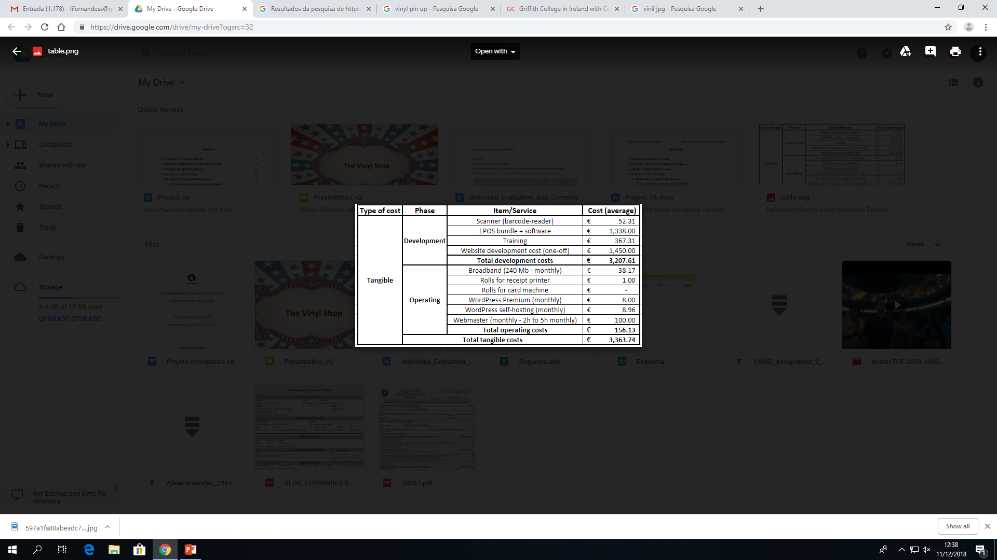
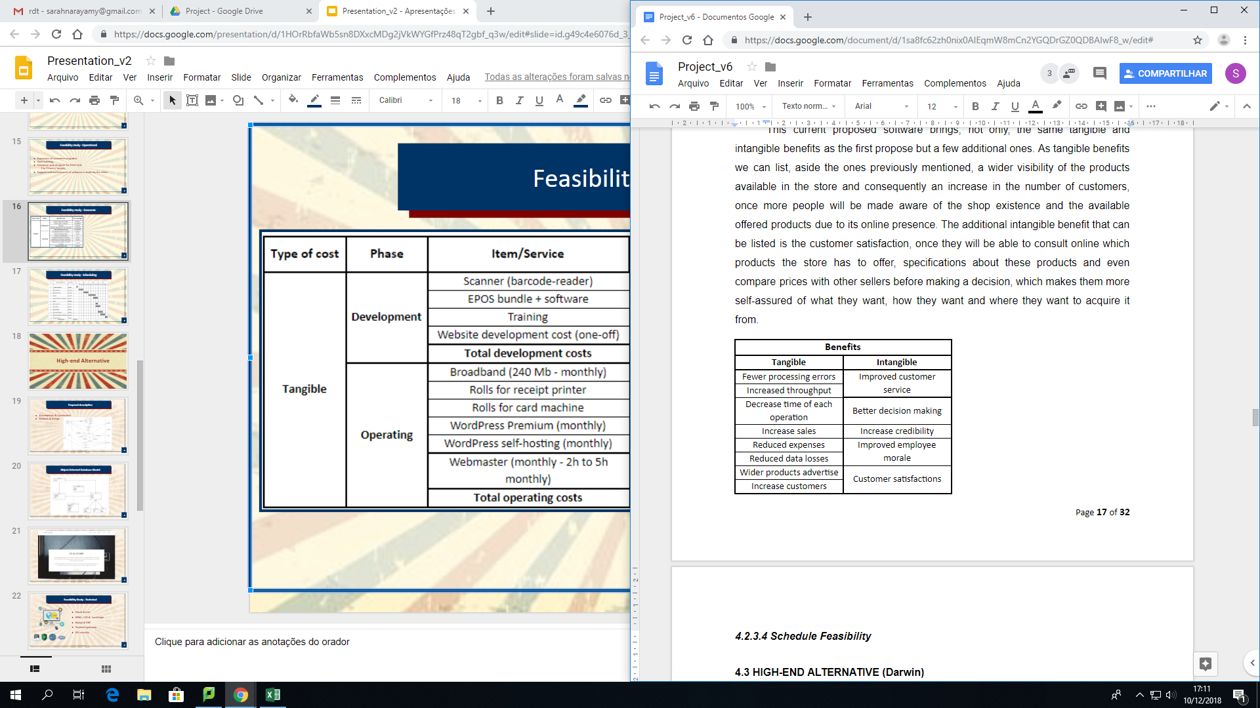
Feasibility study - Economic
17
4

Slide 22
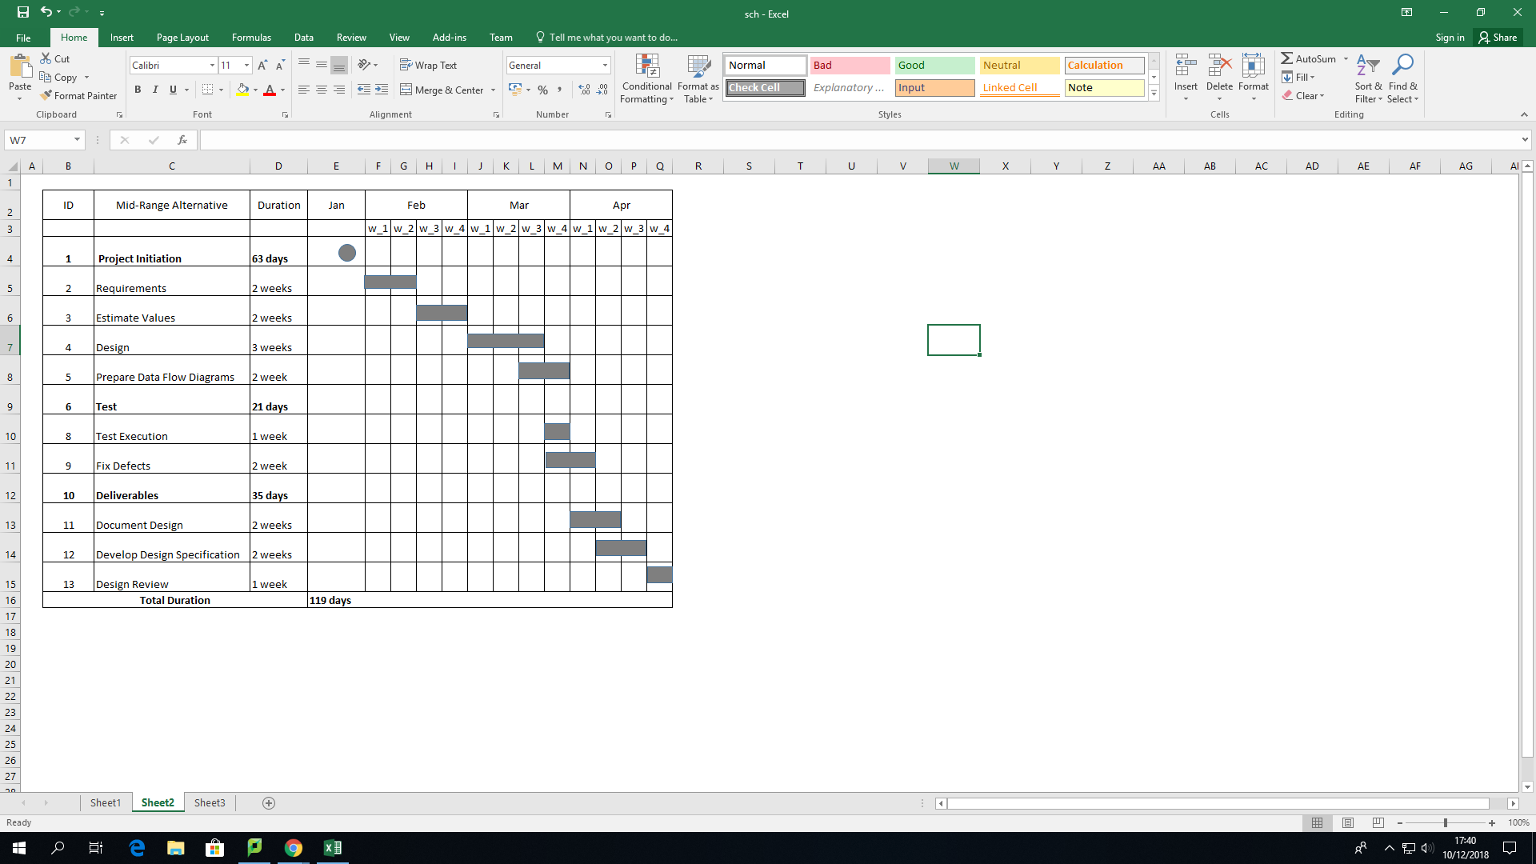
Feasibility study - Scheduling
18
4

Slide 23
High-end Alternative

Slide 24
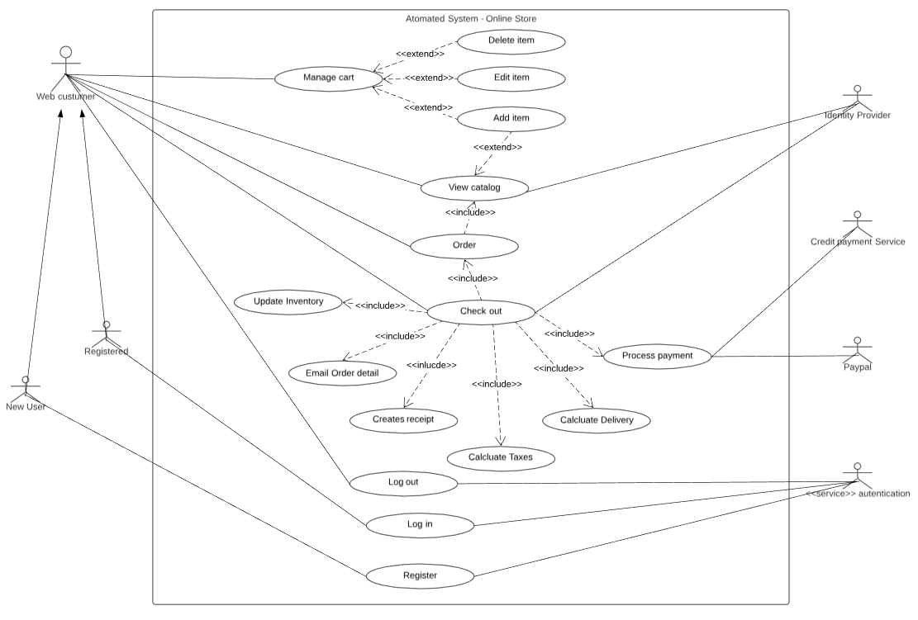
Proposal description
Assumptions & Constraints
Analysis & design
19

Slide 25
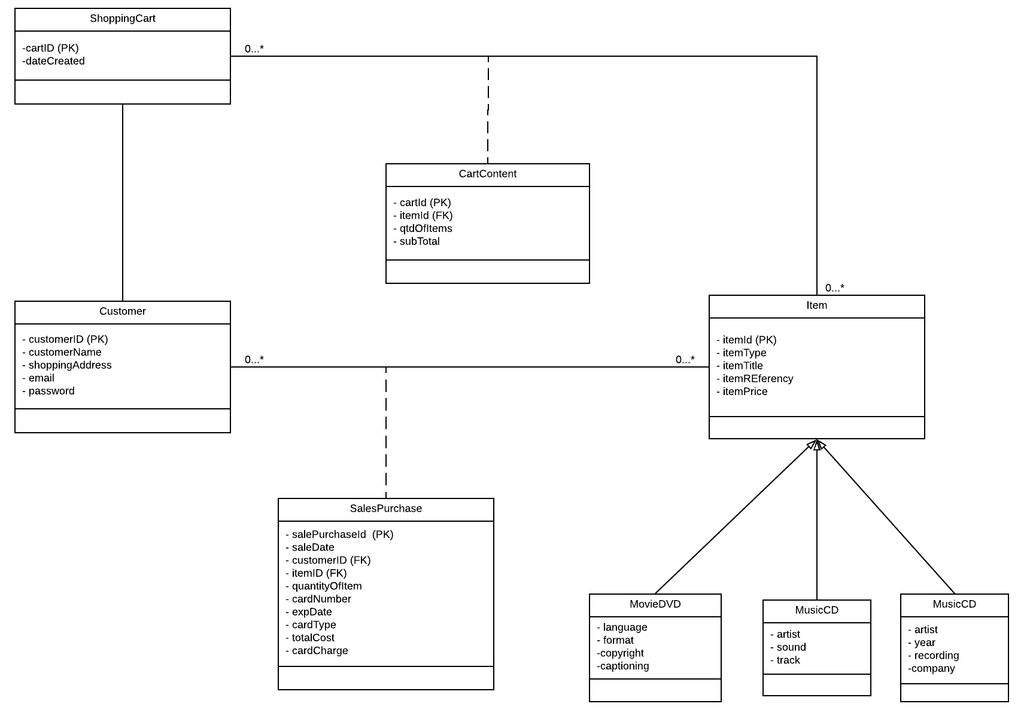
Object-Oriented Database Model
20

Slide 26
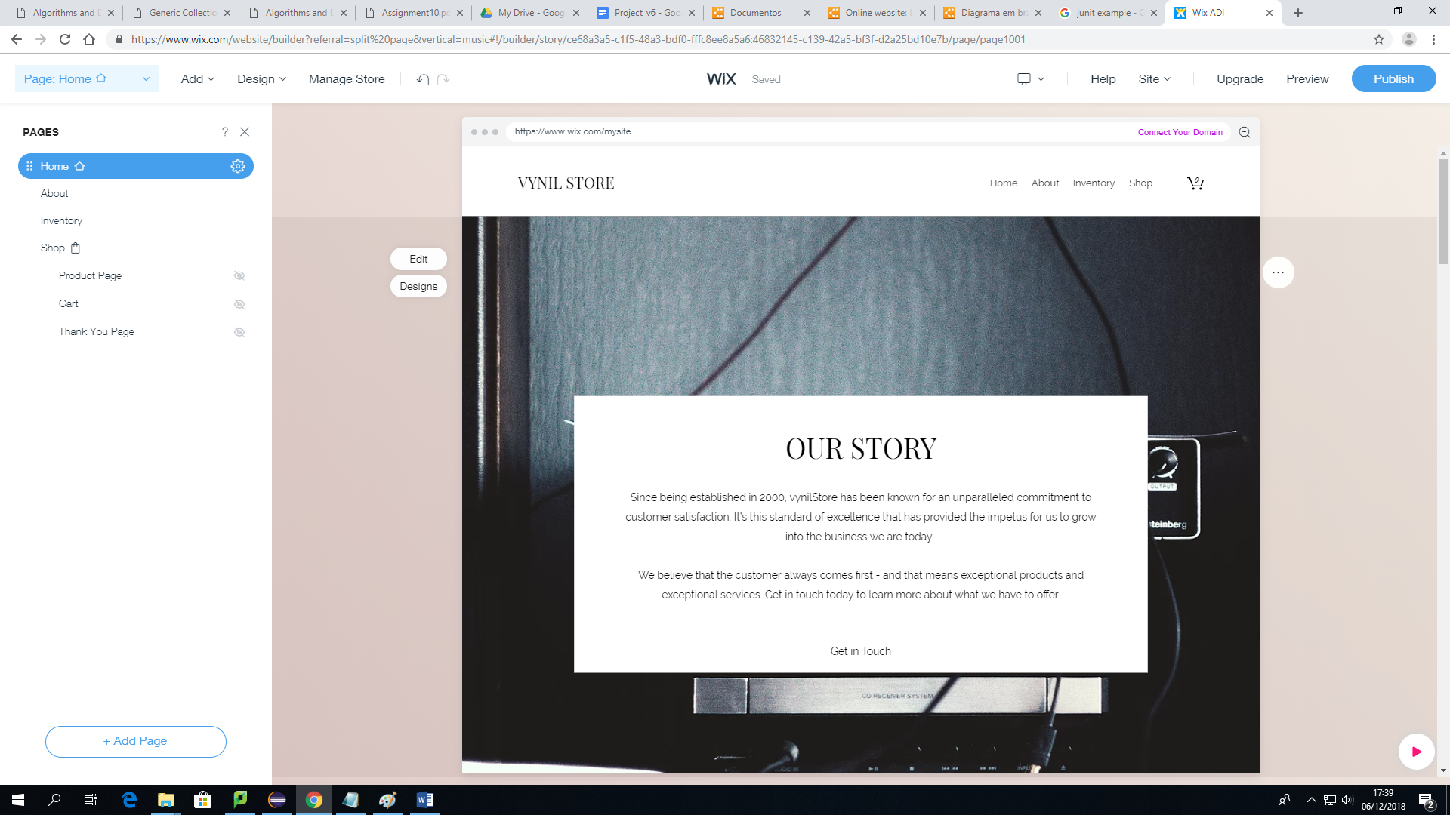
Design
21

Slide 27





Feasibility Study - Technical
Cloud Server
HTML, CSS & JavaScript
MySql & PHP
Payment gateway
SSL security
22

Slide 28

Feasibility Study - Operational
Training Staff
EPoS system
Freelancer Web developer
Website maintenance
23

Slide 29
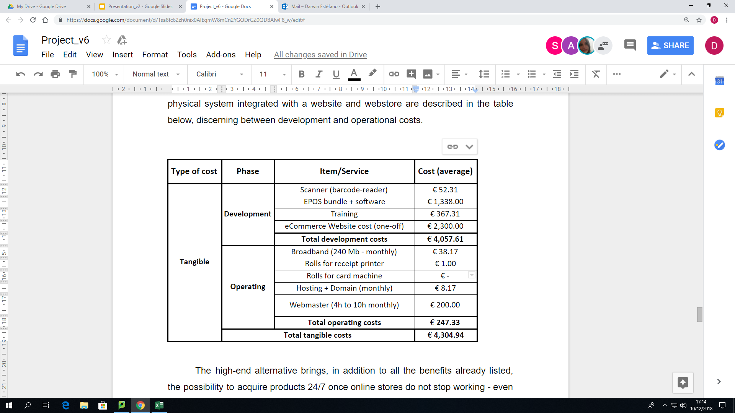
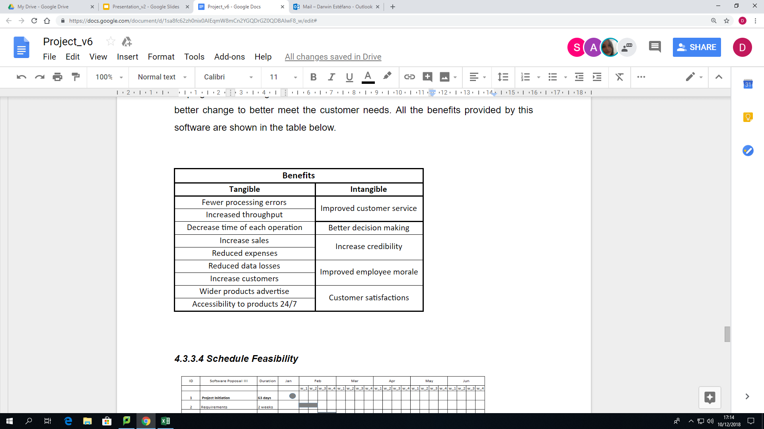
Feasibility Study - Economical
24

Slide 30
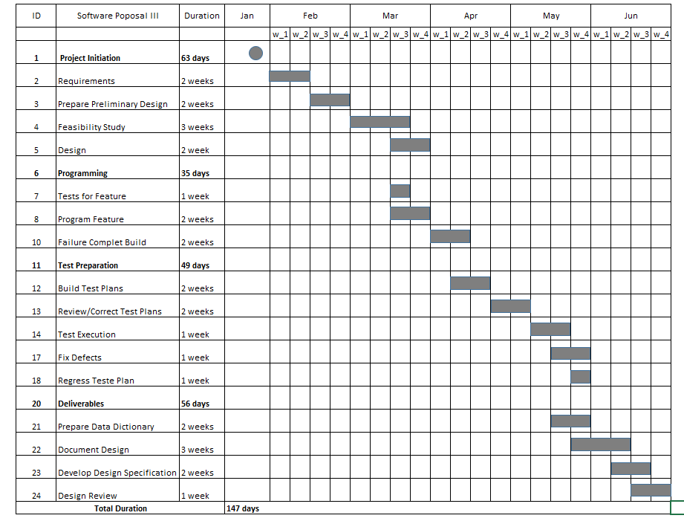
Feasibility Study - Scheduling
25

Slide 31
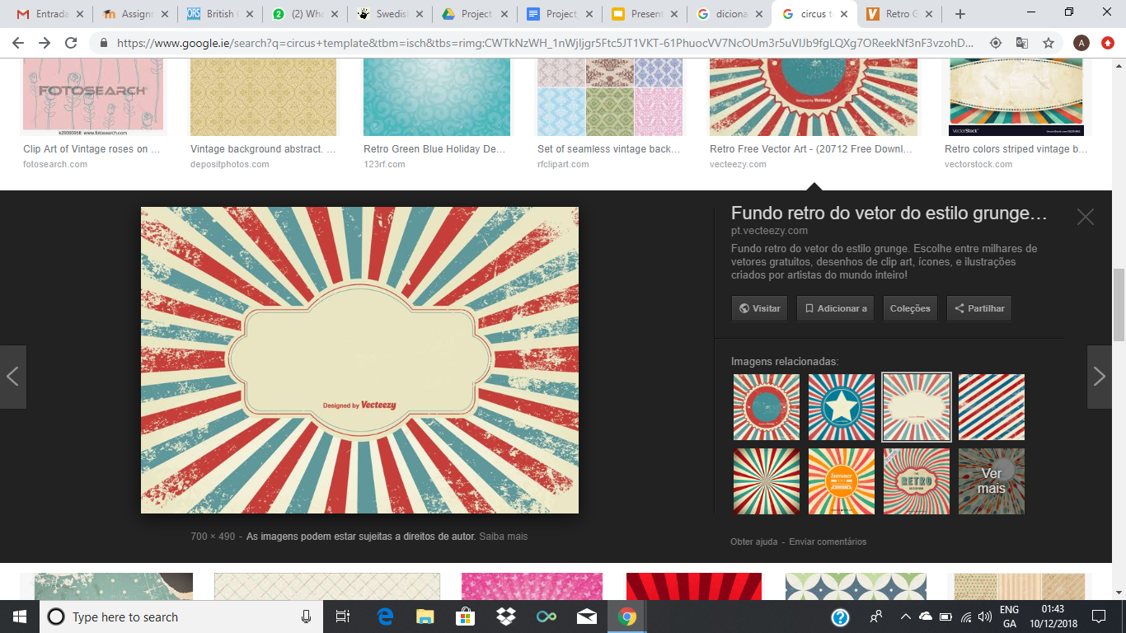
Recommendation and Conclusion

Slide 32

Recommendation
The choice will be based not only on the comprehensiveness of the proposal, but also considering the available budget to the project implementation.
26

Slide 33
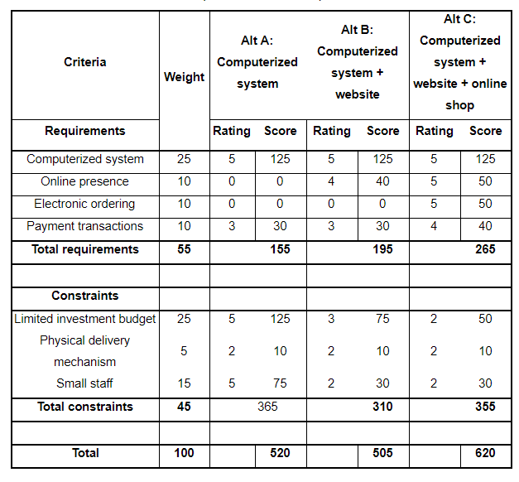
27

Slide 34

Conclusion
The final decision about which one is more adequate to the shop is concerned to the owner, who will balance the relevance, goals and available budget and time to be invested in the revitalization of the business.
28

Slide 35

Thanks for your attention!
Questions?
Notes:
THE END: Thanks the audience and opens space for questions

Slide 36
Aline Fernandes 2962245
Amandio Pinto 2938072
Darwin Machado 2948811
Paula Oehme 2957903
Sarah Silva 2960992
Notes:
INTRODUCTION: theme (Vinyl Shop) + introduce the group + establish that the questions should be asked in the end of the presentation

